Slide 1
Ground Station to Satellite Path Loss Prediction Model: A Comparative Study Between A Machine Learning Model and A Mathematical Model
Bangladesh University of Engineering and Technology
Department of Electrical and Electronic Engineering
EEE 400 (January 2024) UNDERGRADUATE THESIS
Presentation Date: 17th March 2025
Presented by:
H.A. Hassan Tahmid Student ID: 1806129
A. S. M. Abrar Tanvir Toki Student ID: 1806029
Supervised by:
Dr. Pran Kanai Saha
Professor, EEE, BUET
Members:
Dr. Md. Shah Alam
Professor, EEE, BUET
Dr. Md. Asiful Islam
Associate Professor, EEE, BUET

Slide 2

Outline of Presentation
Summary
Acknowledgement and References
Background Work
Result Analysis
Methodology
Conclusion
Motivation

Slide 3
Introduction
Path loss refers to the reduction in signal strength as it travels from the transmitter to the receiver.
Importance of Path Loss Calculation
Factors Affecting Path Loss
Critical for designing efficient communication systems
Helps ensure signal reliability in satellite communications
Distance between satellite and Earth-station
Atmospheric Conditions
Interference and Obstacles in the signal path

Slide 4

Motivation
Problem
Dummy Signals & Constant Monitoring
05
Bangladesh Satellite - 1
Case study
Goal
Reducing Dependency on the conventional method

Slide 5
Background Work
Predicting Path Loss Distribution of an Area From Satellite Images Using Deep Learning
Path Loss Prediction Based on Machine Learning Techniques: Principle Component Analysis, Artificial Neural Network, and Gaussian Process
A Deep-Learning Method for Path Loss Prediction Using Geospatial Information and Path Profiles
Real Time Prediction of Total Atmospheric Attenuation for mm-wave bands Satellite Links over Indian Region

Slide 6
Summary
Compare!!!
Prediction Model
Mathematical Model
Machine Learning Model
Collecting Attenuation Data From BCSCL
Prepare Predicting Model
Analyze the Prediction

Slide 7
Data Collection (Part-1)
Synthetic Dataset Features
Latitude
Elevation
Altitude
Longitude
Clutter Height
Distance
Path Loss (dB)
Dataset Fetch
ANN Model with PCA
Terrible Accuracy!!

Slide 8
Data Collection (Part-2)
Transmitter-Side Information:
Longitude
Transmitter Power
Frequency Band
Polarization Type
Environment Type
Weather Condition
Humidity Level
Temperature
Atmospheric Pressure
Latitude
Elevation
Transmitter Height
Antenna Gain
Season
Clutter Height
Line of Sight

Slide 9
Data Collection (Part-2)
Receiver-Side Information:
Satellite Altitude
Satellite Latitude
Satellite Longitude
Satellite Antenna Gain
Beam Type
Polarization Type
Space Weather Condition
Power Settings
Transmission Mode
Path Length
PATH LOSS

Slide 10
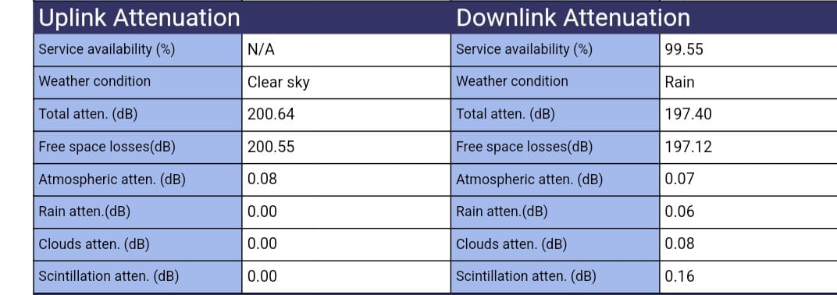
Data Collection (Part-3)
For C-band:
Repeater Gain: 111.2 dB

Slide 11
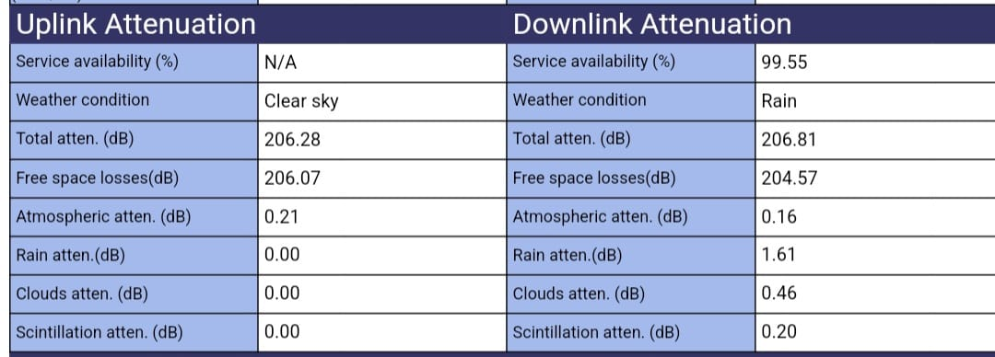
Data Collection (Part-3)
For Ku-band:
Repeater Gain: 125.4 dB

Slide 12
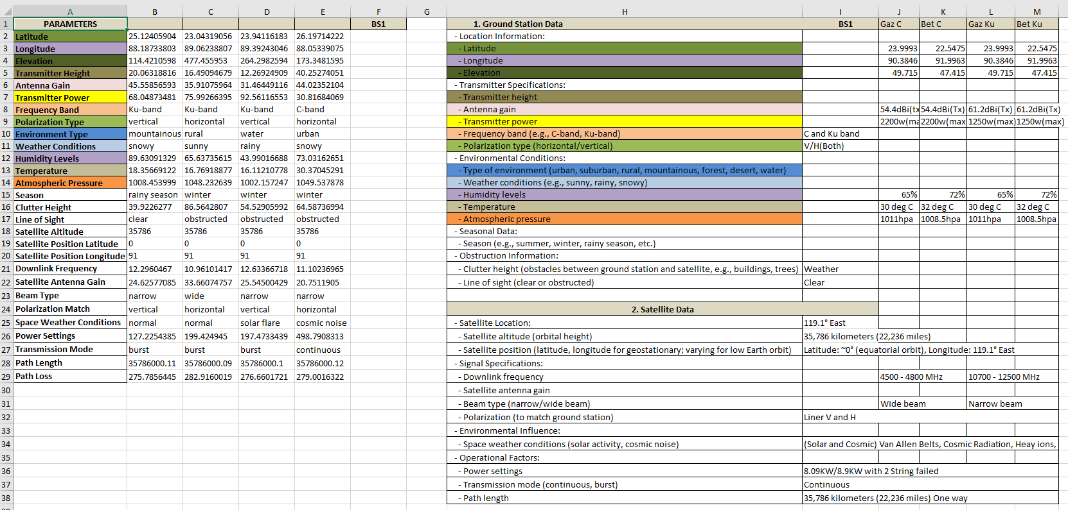
Data Collection (Part-3)

Slide 13
Data Collection (Part-4)
BCSCL (Bangladesh Communication Satellite Company Limited)
BMD (Bangladesh Meteorological Department)
Align timestamps from BCSCL and BMD

Slide 14

Improving ML Model
“If a model excels in a highly random synthetic dataset, It will perform even better on real-world data.”

Slide 15
Continuous Attempts & the improvement of ML Model
Attempt 1:
6 factors
Applying PCA & ANN Model
Poor accuracy
Mean Squared Error 78.35
Attempt 2:
Improved ANN Model
More Robust Against Overfitting
Decreased Mean Squared Error 64.12
Attempt 3:
Hybrid Machine Learning Approach Integrating ANN, Random Forest , Voting Regressor
More Generalized and flexible
Mean Squared Error 8.63

Slide 16
Continuous Attempts & the improvement of ML Model
Attempt 4:
Removal of ANN & adopting only Random Forest
Simplified approach
Slightly better accuracy
Attempt 5:
Huge dataset with the consideration of 27 factors
More features , categorical encoding
Great step towards real world data handling
Impressive 73% accuracy
Attempt 6:
Introduces XGBoost alongside Random Forest (RF)
XGBoost increased the accuracy from 73% to 82%

Slide 17
Continuous Attempts & the improvement of ML Model
Attempt 7:
Optimized XGBoost with Stacking
Real Dataset
Free Space Path Loss Prediction showed 90.62% accuracy
Attempt 8:
Optimized RF Model with one-hot encoding
Based on original features (more interpretable)
Resulting in an 91.36% accuracy

Slide 18
Mathematical Model
Cloud Attenuation
Uplink Frequency
Liquid Water Temperature in Clouds
Rain Attenuation
Rain Rate
Uplink Frequency
Atmospheric Attenuation
Attenuation Due to Water Vapor
Attenuation Due to Oxygen
Liquid Water Density in Clouds
Cloud Base Height
Elevation Angle
Polarization
Elevation Angle
Path Length

Slide 19
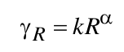
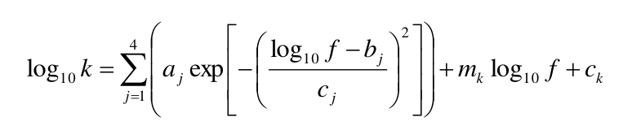
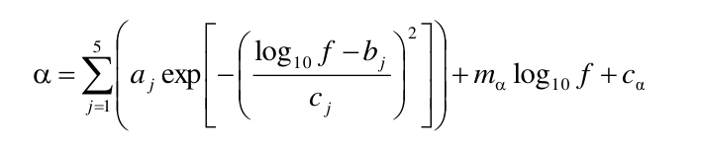
Rain Attenuation Calculation
Formula:
Where,

Slide 20
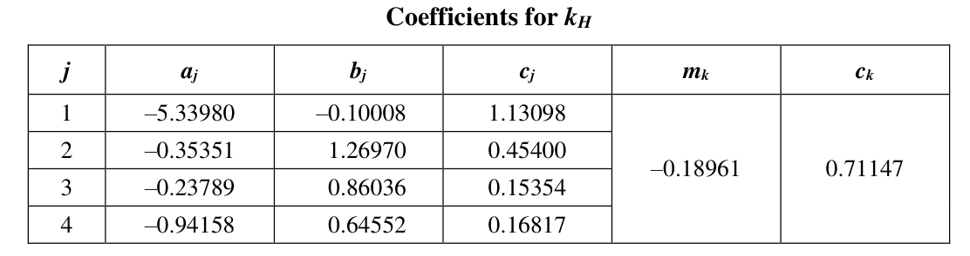
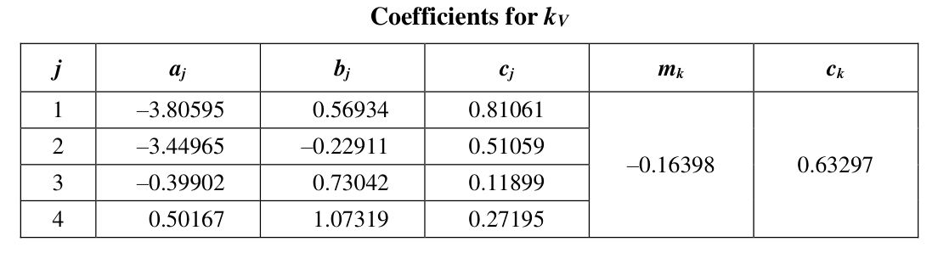
Rain Attenuation Calculation

Slide 21
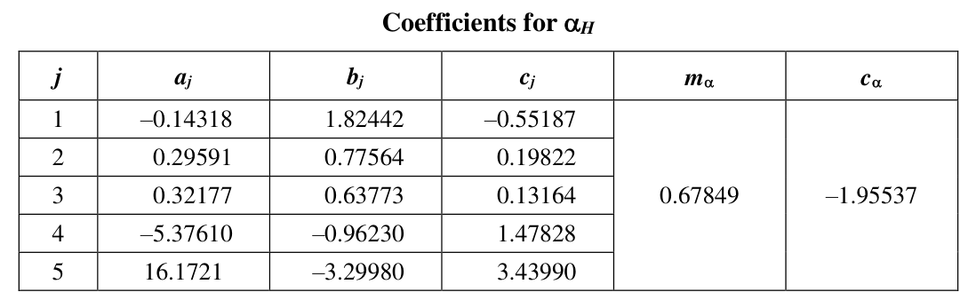
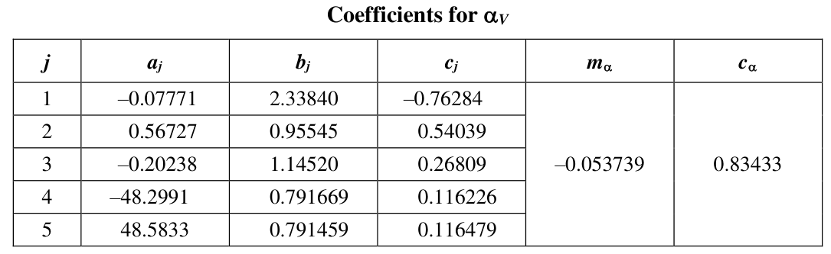
Rain Attenuation Calculation

Slide 22
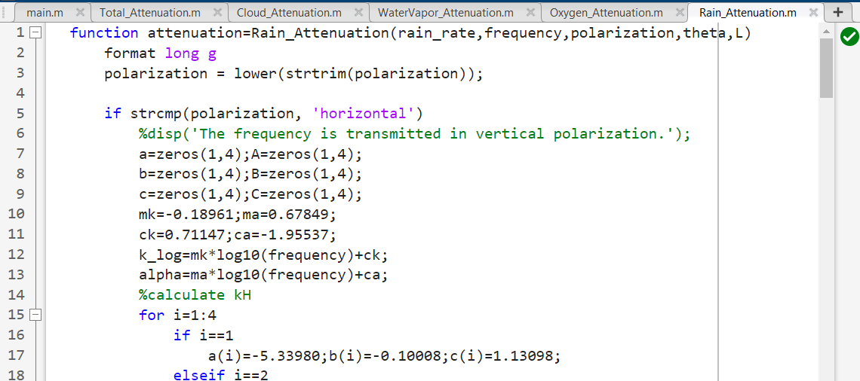
Rain Attenuation Calculation
Rain Attenuation
Rain Rate
Frequency
Polarization
Elevation angle
Path Length

Slide 23
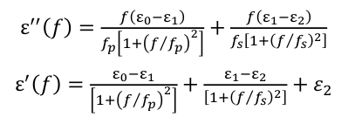
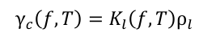
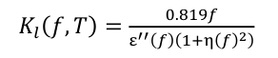
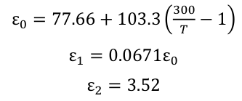
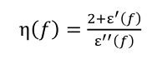
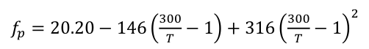
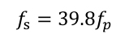
Cloud/Fog Attenuation Calculation
Formula:
Where,

Slide 24

Data Collection (Part-4)
BCSCL (Bangladesh Communication Satellite Company Limited)
BMD (Bangladesh Meteorological Department)
Align timestamps from BCSCL and BMD
Limitation
No Cloud Base Height!!

Slide 25
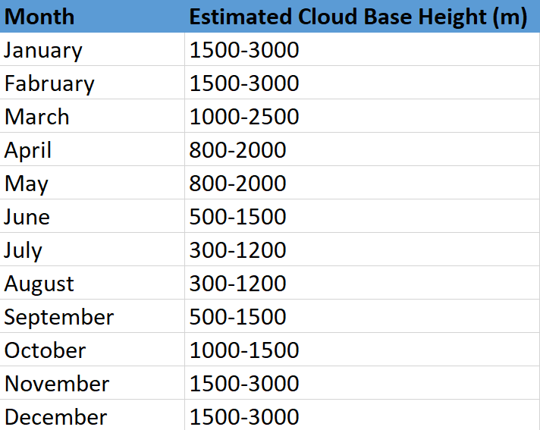
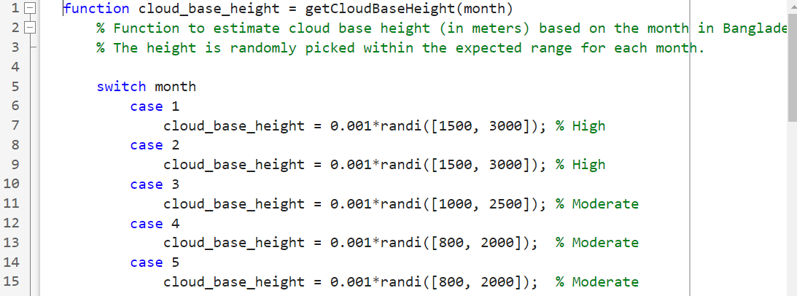
Generate a Function for Cloud Height

Slide 26
Cloud/Fog Attenuation Calculation
Cloud/Fog Attenuation
Frequency
Liquid Water Temperature in Clouds
Liquid Water Density in Clouds
Cloud Base Height (Assumption)
Elevation Angle

Slide 27
Atmospheric Attenuation Calculation
Attenuation due to Oxygen
Attenuation due to Water Vapor
Total Atmospheric Attenuation

Slide 28
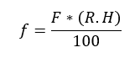
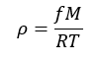
Attenuation Due to Oxygen
Oxygen Attenuation
Frequency
Dry Air Pressure (Partial)
Water Vapor Pressure (Partial)
Elevation Angle
Water Vapor Pressure:
Absolute Humidity:

Slide 29
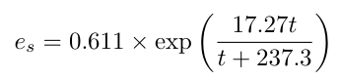
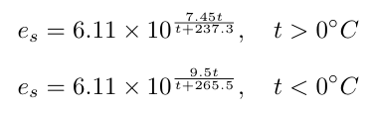
Saturated Water Vapor Pressure Calculation
Teten’s Equation
Magnus Formula
Goff-Gratch Formula

Slide 30
Attenuation Due to Water Vapor
Dry Air Pressure = Total Pressure – Water Vapor Pressure
Water Vapor Attenuation
Frequency
Surface Temperature
Total Surface Pressure
Absolute Humidity
Dry Air Pressure
Water Vapor Pressure
Elevation Angle

Slide 31
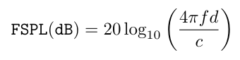
Total Attenuation Calculation
Rain Attenuation
Cloud Attenuation
Total Attenuation
Atmospheric Attenuation
Free Space Path Loss

Slide 32
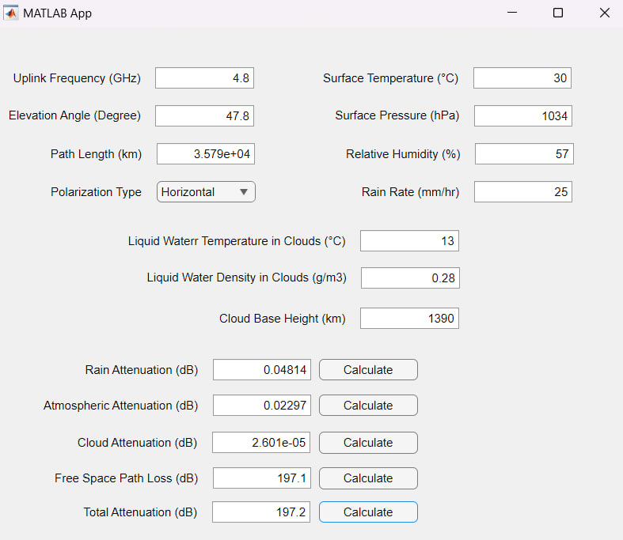
GUI Application

Slide 33
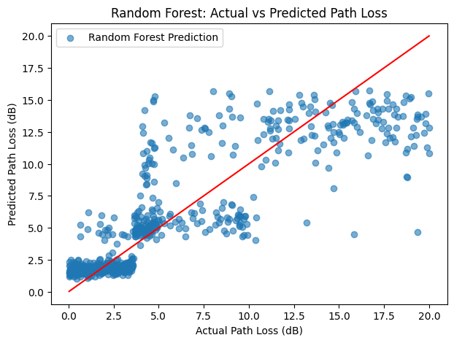
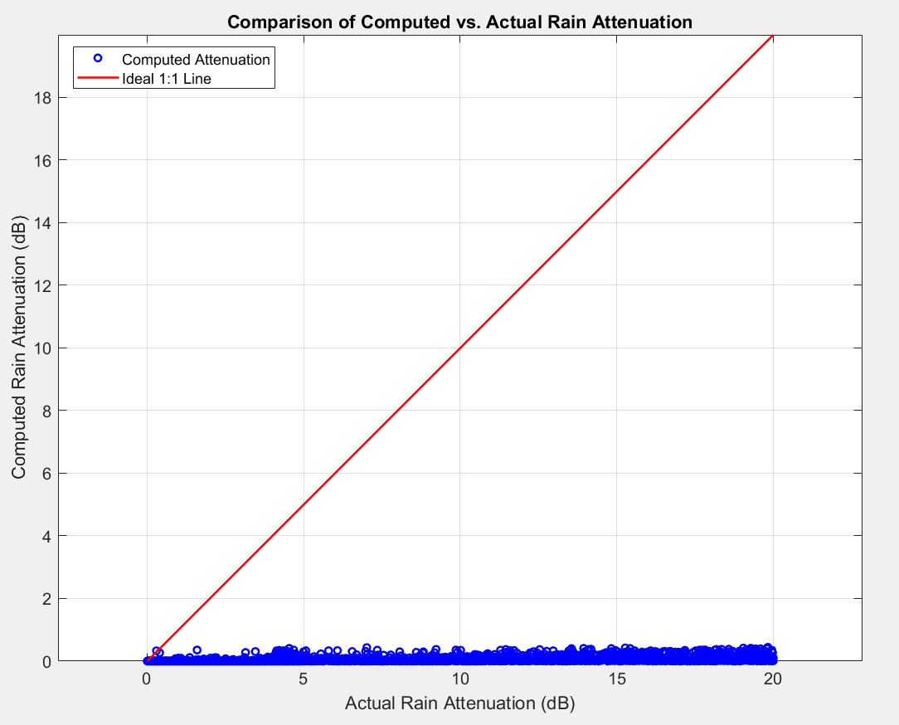
Result Analysis (Rain Attenuation)
Machine Learning Model
Mathematical Model

Slide 34
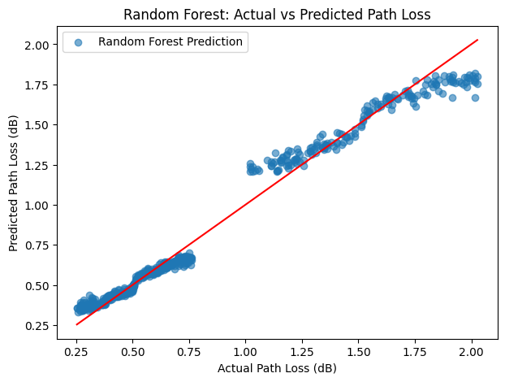
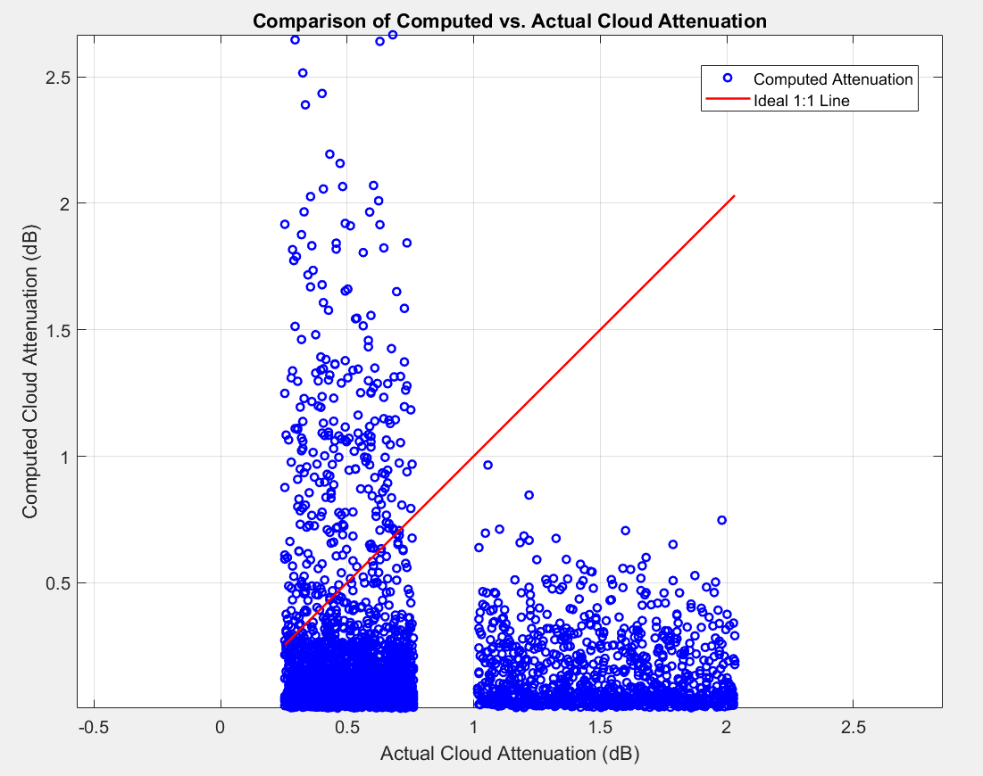
Result Analysis (Cloud Attenuation)
Machine Learning Model
Mathematical Model

Slide 35
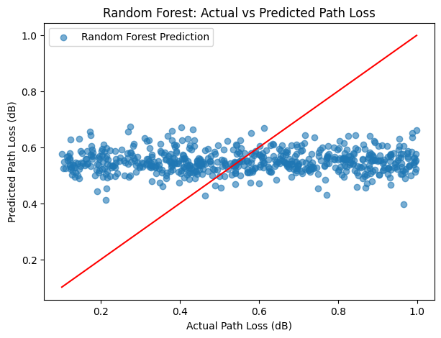
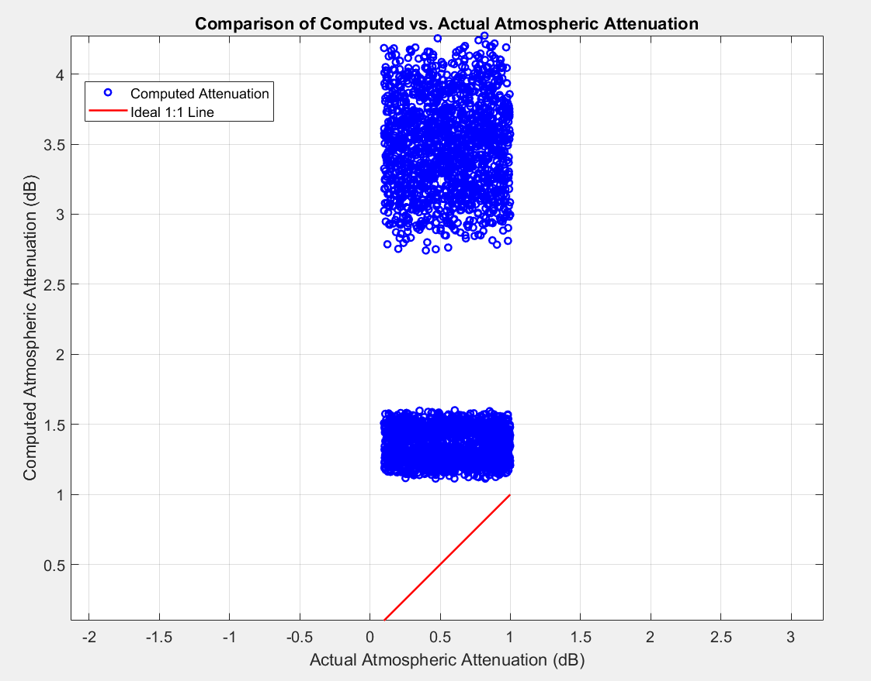
Result Analysis (Atmospheric Attenuation)
Machine Learning Model
Mathematical Model

Slide 36
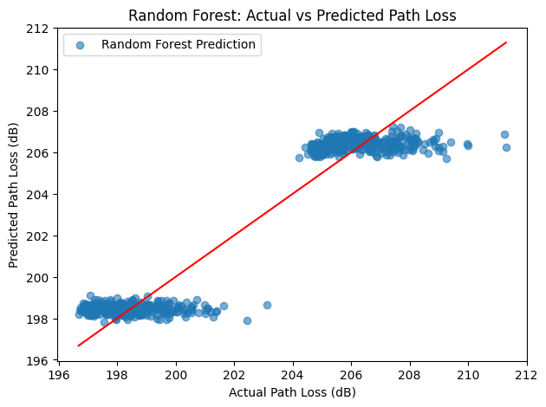
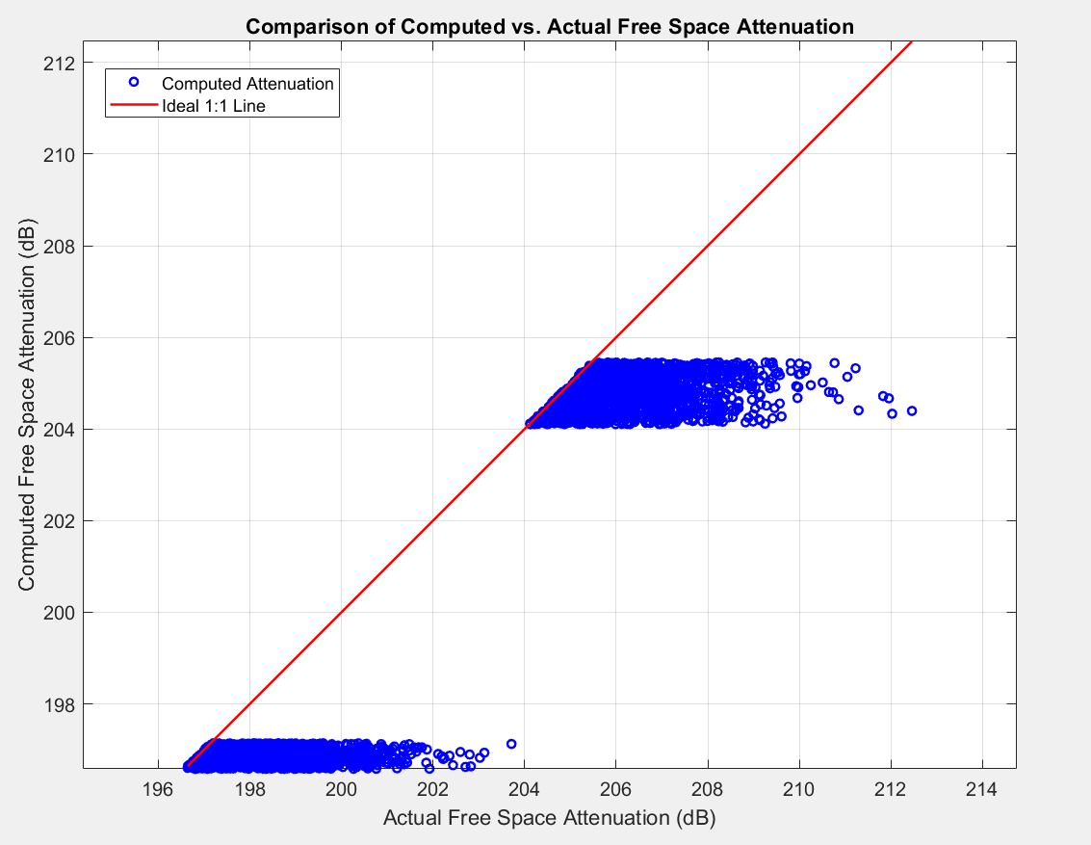
Result Analysis (FSPL)
Machine Learning Model
Mathematical Model

Slide 37
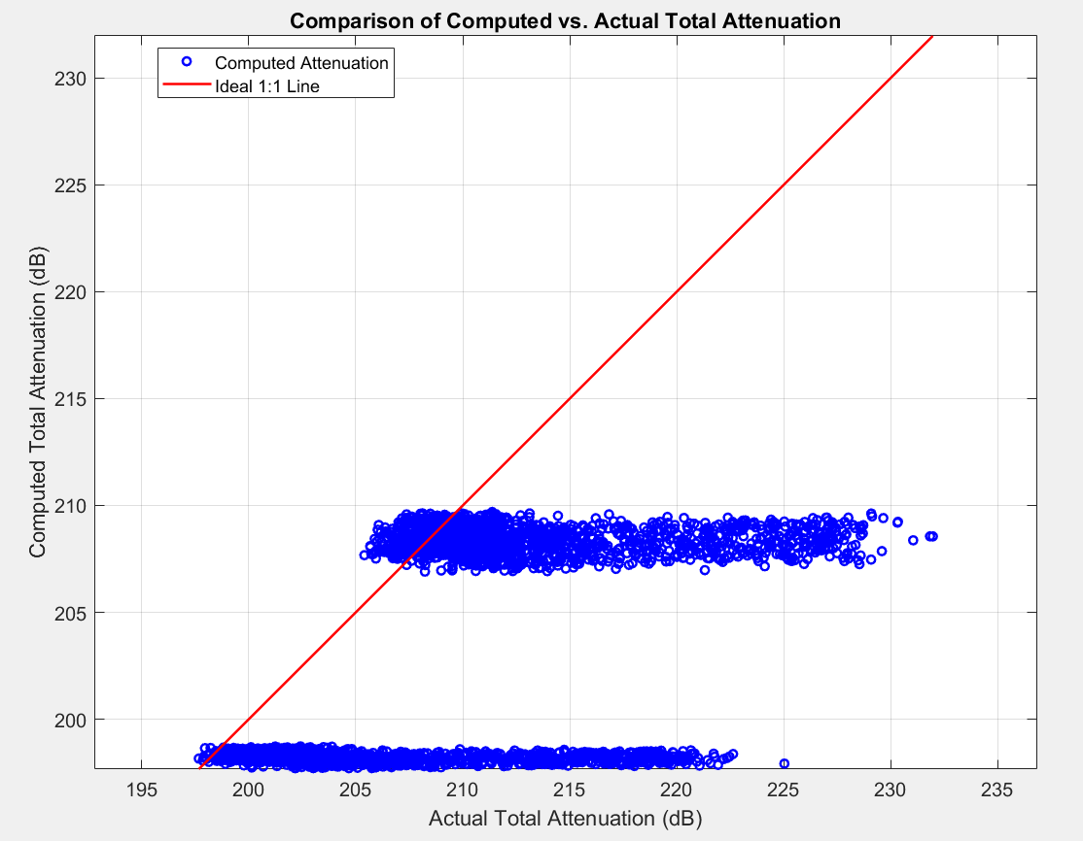
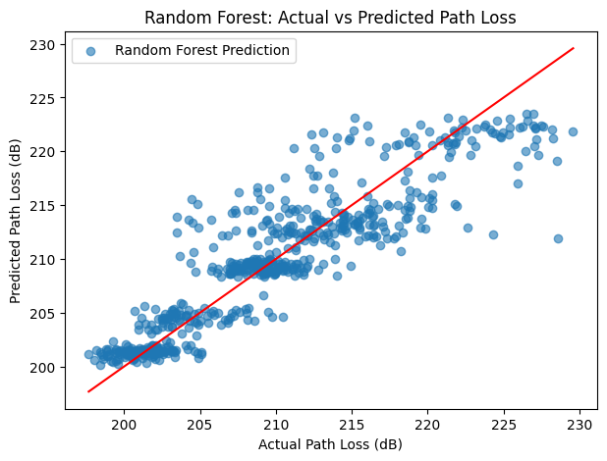
Result Analysis (Total Attenuation)
Machine Learning Model
Mathematical Model

Slide 38
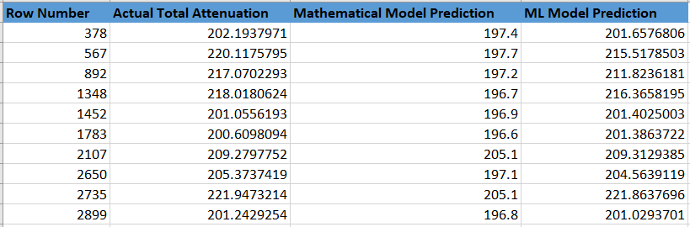
Result Analysis (with Ten random data)

Slide 39
Conclusion
Machine Learning Model
Mathematical Model
Accuracy Rate: 80.43%
MSE: 10.4545
Accuracy Rate: 96.768%
MSE: 86.536

Slide 40
References
Omar Ahmadien, Hasan F Ates, Tuncer Baykas, and Bahadir K Gunturk. Predicting path loss distribution of an area from satellite images using deep learning. IEEE Access, 8:64982--64991, 2020.
Akram Al-Hourani and Ismail Guvenc. On modeling satellite-to-ground path-loss in urban environments. IEEE Communications Letters, 25(3):696--700, 2020.
Mohamed K Elmezughi, Omran Salih, Thomas J Afullo, and Kevin J Duffy. Path loss modeling based on neural networks and ensemble method for future wireless networks. Heliyon, 9(9), 2023.
Takahiro Hayashi and Koichi Ichige. A deep-learning method for path loss prediction using geospatial information and path profiles. IEEE Transactions on Antennas and Propagation, 71(9):7523--7537, 2023.
International Telecommunication Union (ITU-R). Specific attenuation model for rain for use in prediction methods. Technical Report ITU-R P.838-3, International Telecommunication Union (ITU), 2005.
International Telecommunication Union (ITU-R). Attenuation due to clouds and fog. Technical Report ITU-R P.840-9, International Telecommunication Union (ITU), 2019.
International Telecommunication Union (ITU-R). Attenuation by atmospheric gases. Technical Report ITU-R P.676-13, International Telecommunication Union (ITU), 2021.
Han-Shin Jo, Chanshin Park, Eunhyoung Lee, Haing Kun Choi, and Jaedon Park. Path loss prediction based on machine learning techniques: Principal component analysis, artificial neural network, and gaussian process. Sensors, 20(7):1927, 2020.

Slide 41
References
XU Junzeng, WEI Qi, PENG Shizhang, and YU Yanmei. Error of saturation vapor pressure calculated by different formulas and its effect on calculation of reference evapotranspiration in high latitude cold region. Procedia Engineering, 28:43--48, 2012.
Kiyas Kayaalp, Sedat Metlek, Abdullah Genc, Habib Dogan, and _Ibrahim Bahadir Basyigit. Prediction of path loss in coastal and vegetative environments with deep learning at 5g sub-6 ghz. Wireless Networks, 29(6):2471--2480, 2023.
Dalia Nandi. Real time prediction of total atmospheric attenuation for mm-wave bands satellite links over Indian region. In 2022 URSI Regional Conference on Radio Science (USRI-RCRS), pages 1--4. IEEE, 2022.
Yaohua Sun, Mugen Peng, Yangcheng Zhou, Yuzhe Huang, and Shiwen Mao. Application of machine learning in wireless networks: Key techniques and open issues. IEEE Communications Surveys & Tutorials, 21(4):3072--3108, 2019.

Slide 42


